Slide 1

INSE 6120 – CRYPTOGRAPHIC PROTOCOLS AND NETWORK SECURITY A SURVEY ON MONERO AND ZCASH
Alekhya Chowdary Velicheti 40222533
Amukthamalyada Vellanki 40222749
Gurumurthy Anagandhula 40218549
Lakshmi Vintha 40221985
Shankar Teja Yalavarthy 40225894
Yashwanth Reddy Bandaru 40218189

Slide 2


Overview of Cryptocurrencies
Cryptocurrencies are digital or virtual tokens that use cryptography to secure and verify transaction.
The first and most well-known cryptocurrency is Bitcoin, which was created in 2009.
Cryptocurrencies operate on decentralized networks, meaning that they are not controlled by any single authority or institution.
Some businesses and individuals now accept cryptocurrencies as a form of payment, and many countries are exploring the possibility of creating their own digital currencies.

Slide 3

Introduction to Monero and ZCash
Monero
Monero is a privacy-focused cryptocurrency that allows for anonymous transactions and is designed to be untraceable.
Unlike some other cryptocurrencies, Monero transactions are not visible on a public ledger, making it difficult to trace who is sending and receiving funds.
Monero's privacy features have made it popular for those who value financial privacy and security, as well as for those who wish to use it for illicit activities.
ZCash
ZCash is a cryptocurrency that was designed with a focus on privacy and anonymity.
Like Monero, ZCash uses advanced cryptographic techniques to protect the privacy of its users and their transactions.
ZCash allows for both transparent and shielded transactions, meaning that users can choose to keep their transactions private or make them visible on a public ledger, depending on their preference.

Slide 4
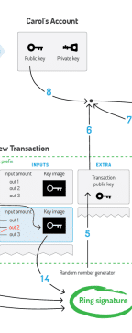
Working Protocol of Monero
Monero uses a protocol called Ring Signatures, which allows for multiple possible senders of a transaction to be mixed together, making it difficult to trace the true sender of the transaction.
Monero also uses stealth addresses, which means that each transaction generates a unique address for the recipient, making it difficult to link transactions to a particular user or address.
Monero's mining process is based on the CryptoNight proof-of-work algorithm, which is designed to be resistant to ASIC mining and more accessible to individual miners using regular CPUs or GPUs. This helps to promote decentralization and maintain the privacy of the Monero network.

Slide 5
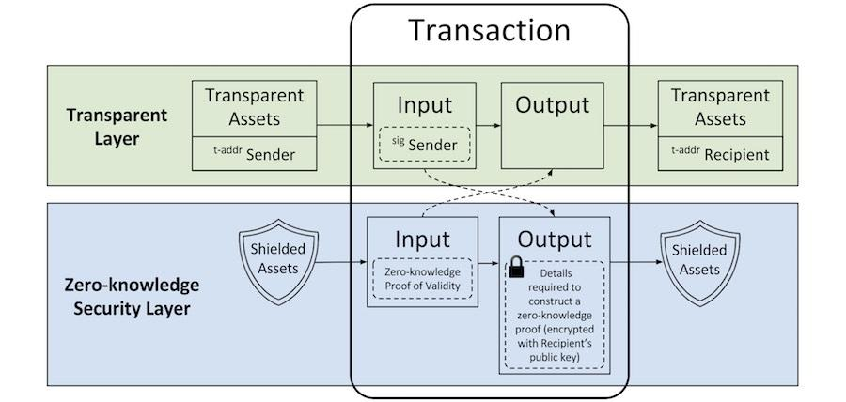
Working Protocol of ZCash
ZCash uses a unique zero-knowledge proof called zk-SNARKS to verify transactions without revealing any sensitive information about the sender, receiver, or transaction amount.
In a ZCash transaction, the sender can choose to make the transaction transparent or shielded, with shielded transactions providing greater privacy but also requiring more computational resources.
ZCash's mining process is similar to that of Bitcoin, with miners competing to solve complex cryptographic puzzles in order to add new blocks to the blockchain and earn rewards in the form of ZCash coins.

Slide 6
Attack Scenarios and Countermeasures
Attacks like cache side-channel attacks could be used by an adversary co-located with a user's wallet. Such adversaries, however, are expressly excluded from the threat model taken into account by Monero and Zcash.
Goals of the attacker include figuring out whether two transactions pay the same address and how a known user connects to the P2P network.
If the owner doesn't utilise anonymizing software like Tor, the adversary can connect a public key to the IP address of her P2P node. The victim can be geo-localized or de-anonymized using this information.
An attacker can identify whether two public keys are for the same user if they are given two public keys. The attacker attempts to identify the same node or wallet by sending a transaction to each public key. The unlinkability feature of varied addresses is violated by this.
The flaws in several of our assaults also provide opportunities for side-channel timing extraction of a victim's secret "viewing" key. If this key is stolen, the attacker can link all transactions sent to the victim passively

Slide 7
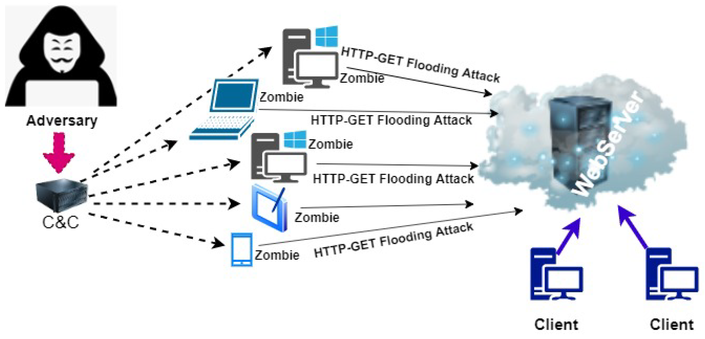
The Transaction Flooding Attack
This attack analyses the ring signature mechanism of Monero, which hides the genuine input keys by combining them with various output keys produced by earlier transactions.
The transaction flooding attack's fundamental concept is straightforward. A large knowledge base, or set of output keys, must be accumulated by the attacker in order for the system to choose keys to be utilised as mixins in upcoming transactions.
In order to establish an input ring of size 11 in Monero, each input must have 10 mixins in addition to the real spend key for each new transaction.
The system adds the mixins to the transaction's input after selecting them from the output keys of earlier transactions using a decoy picker that makes use of a gamma distribution

Slide 8
Similarities Between Monero and ZCash
Purpose
Open Source
Teams
Crypto-Jacking

Slide 9
Differences Between Monero and ZCash
Speed
Usage
Cost of fees
Scalability
Market History

Slide 10
Conclusion
We have surveyed the potential side-channel attacks on wallet processing as well as attack scenarios on cryptocurrency anonymous transactions. Moreover, we recommend defenses employing anonymity overlay networks and side-channel-free cryptography implementations.
There are so many cryptocurrency projects out there, even in the field of privacy coins, that it is overwhelming. And privacy coins are the clearest example of this. With ZCash and Dash as its major rivals, Monero is expected to maintain its position as the leading privacy currency. Compared to both combined, Monero presently has a bigger market cap.

Slide 11
References
Bitinfocharts.com.
A. Biryukov and S. Tikhomirov, "Deanonymization and Linkability of Cryptocurrency Transactions Based on Network Analysis," 2019 IEEE European Symposium on Security and Privacy (EuroS&P), Stockholm, Sweden, 2019, pp. 172-184, doi: 10.1109/EuroSP.2019.00022.
J. -H. Lee, "Rise of Anonymous Cryptocurrencies: Brief Introduction," in IEEE Consumer Electronics Magazine, vol. 8, no. 5, pp. 20-25, 1 Sept. 2019, doi: 10.1109/MCE.2019.2923927.
A. Averin, A. Samartsev and N. Sachenko, "Review of Methods for Ensuring Anonymity and De-Anonymization in Blockchain," 2020 International Conference Quality Management, Transport and Information Security, Information Technologies (IT&QM&IS), Yaroslavl, Russia, 2020, pp. 82-87, doi: 10.1109/ITQMIS51053.2020.9322974.
“Monero. private digital currency,” 2018, https://getmonero.org/.
https://z.cash
https://en.wikipedia.org/wiki/Zcash
https://en.wikipedia.org/wiki/Monero

Slide 12


